Slide 1
SOFT COMPUTING MODULE-2: Memory Models
Dr. B.K.Tripathy

Slide 2
SYLLABUS
Pattern association
Auto associative memory models
Hetero associative memory models
BAM
Hopfield network

Slide 3
PATTERN ASSOCIATION

Slide 4
PATTERN ASSOCIATION
Pattern association is carried out efficiently by associative memory networks
An associative network is a single-layer net in which the weights are determined in such a way that the net can store a set of pattern associations.
Each association is an input-output vector ( pair s:t)
The two main algorithms used for training a pattern association network are
The Hebb rule
The outer products rule

Slide 5
ASSOCIATIVE MEMORY NETWORK
It stores a set of patterns as memories
When it is presented with a key pattern, it responds by producing one of the stored patterns
The selected pattern resembles or relates to the key pattern
The recall is through association of the key pattern
These types of memories are called content- addressable memories (CAM)
In digital computers we have address- addressable memories
As in RAM/ROM it is also a matrix memory

Slide 6
ASSOCIATIVE MEMORY NETWORK CONTD…
The input data is correlated with that of the stored data in CAM
The stored patterns must be unique (That is different patterns are stored in different locations)
Each data stored has an address
If multiple copies are stored the data will be correct. But the address will be ambiguous
The concept behind this search is to output any one or all stored items which matches the given search argument
The stored data is retrieved completely or partially

Slide 7
ASSOCIATIVE MEMORY NETWORK CONTD…
Two types of such networks are there
AUTO ASSOCIATIVE
HETERO ASSOCIATIVE
If the output vector is same as the input vectors it is Auto Associative
If the output vectors are different from the input vectors it is Hetero Associative
To find the similarity we use the Hamming distance

Slide 8
HAMMING DISTANCE
Suppose we have two vectors,
Then the Hamming Distance is defined as
The hamming distance basically denotes the number of places where the two vectors differ

Slide 9
TRAINING ALGORITHMS FOR PATTERN ASSOCIATION
There are two algorithms for training of pattern association nets
1. Hebb Rule
2. Outer Products Rule
Hebb Rule
This is widely used for finding the weights of an associative memory neural net
Here, the weights are updated until there is no weight change

Slide 10
ALGORITHMIC STEPS FOR HEBB RULE
STEP 0: Set all the initial weights to zero
( )
STEP 1: For each training target input output vector pairs (s:t) perform steps 2 to 4
STEP 2: Activate the input layer units to current training input
( )
STEP 3: Activate the output layer units to the target output
( )
STEP 4: Start the weight adjustments

Slide 11
OUTER PRODUCT RULE
Here, we have
Input:
Output:
The outer product is defined as: The product of the two matrices:
So, we get the weight matrix W as:
W=S.T = =

Slide 12
OUTER PRODUCT RULE CONTD…
In case of a set of patterns, s(p): t(p), p=1,…P; we have
For the weight matrix W =

Slide 13
AUTOASSOCIATIVE MEMORY NETWORK
The training input and target output vectors are the same
The determination of weights of the association net is called storing of vectors
The vectors that have been stored can be retrieved from distorted (noisy) input if the input is sufficiently similar to it
The net’s performance is based on its ability to reproduce a stored pattern from a noisy input
NOTE: The weights in the diagonal can be set to ‘0’. These nets are called auto-associative nets with no self-connection

Slide 14
ARCHITECTURE OF AUTOASSOCIATIVE MEMORY NETWORK
A
x1
X1
w11
Y1
y1
wi1
wn1
w1i
Yi
xi
Xi
yi
wii
wni
w1n
win
xn
Xn
Yn
yn
wnn

Slide 15
TRAINING ALGORITHM
This is same as that for the Hebb rule. Except that there are same number of output units as the number of input units
STEP 0: Initialize all the weights to ‘0’
( )
STEP 1: For each of the vector that has to be stored, perform
steps 2 to 4
STEP 2: Activate each of the input unit ( )
STEP 3: Activate each of the output units ( )
STEP 4: Adjust the weights, i, j = 1,2,…n;

Slide 16
TESTING ALGORITHM
The associative memory neural network can be used to determine whether the given input vector is a “known” one or an unknown one
The net is said to recognize a vector if the net produces a pattern of activation as output, which is the same as the one given as input
STEP 0: Set the weights obtained from any of the two methods described above
STEP 1: For each of the testing input vector perform steps 2-4
STEP 2: Set the activations of the input unit as equal to that of the input vector

Slide 17
TESTING ALGORITHM CONTD…
STEP 3: Calculate the net input to each of the output unit:
STEP 4: Calculate the output by applying the activation over the net input:
THIS TYPE OF NETWORK IS USED IN SPEECH PROCESSING, IMAGE PROCESSING, PATTERN CLASSIFICATION ETC.

Slide 18
EXAMPLE---AUTOASSOCIATIVE NETWORK
Train the autoassociative network for input vector [-1 1 1 1] and also test the network for the same input vector.
Test the autoassociative network with one missing, one mistake, two missing and two mistake entries in test vector.
The weight matrix W is computed from the formula
Here, P = 1.

Slide 19
COMPUTATIONS
S
Case-1: testing the network with the same input vector
Test input: [-1 1 1 1]
The weight obtained above is used as the initial weights

Slide 20
COMPUTATIONS
Applying the activation function
Over net input, we get
y = [-1 1 1 1]
Hence, the correct response is obtained
TESTING AGAINST ONE MISSING ENTRY
Case 1: [0 1 1 1] (First Component is missing)
Compute the net input

Slide 21
COMPUTATIONS
S
Applying the activation function taken above, we get
y = [-1 1 1 1]. So, the response is correct
TESTING AGAINST ONE MISSING ENTRY
Case 2: [-1 1 0 1] (Third Component is Missing)
Compute the net input

Slide 22
COMPUTATIONS
S
Applying the activation function taken above, we get
y = [ -1 1 1 1]
The response is correct.
WE CAN TEST FOR OTHER MISSING ENTRIES SIMILARLY
Testing the network against one mistake entry
Case 1: Let the input be [-1 -1 1 1] (Second Entry is a Mistake)

Slide 23
COMPUTATIONS
Compute the net input
Applying the same activation function taken above,
y = [-1 1 1 1]
So, the response is correct
Case 2: Let the input be [1 1 1 1] (First entry is mistaken)

Slide 24
COMPUTATIONS
Compute the net input
Applying the activation function taken above
y = [-1 1 1 1]
So, the response is correct
Testing the net against two missing entries
Case 1: Let the input be [0 0 1 1] (First two entries are missing)

Slide 25
COMPUTATIONS
Compute the net input
Applying the activation function taken above
y = [-1 1 1 1], which is the correct response
Case 2: Let the input be [-1 0 0 1] (Second & Third inputs are missing)
Compute the net input

Slide 26
COMPUTATIONS
S
Applying the input function taken above
y = [-1 1 1 1], which is the correct response
Testing the net against two mistaken entries
Let the input be [-1 -1 -1 1] (Second & Third inputs are missing)

Slide 27
COMPUTATIONS
Compute the net input
Applying the activation function taken above, we get
y = [0 0 0 0]. Which is not correct.
SO, THE NETWORK FAILS TO RECOGNISE INPUTS WITH TWO MISTAKES
NOTE: WE HAVE TO CHECK FOR ALL POSSIBLE INPUTS UNDER EACH CASE TO HAVE A POSITIVE CONCLUSION

Slide 28
HETEROASSOCIATIVE MEMORY NETWORK
The training input and target output are different
The weights are determined in such a way that the net can store a set of ‘P’ pattern associations
Each input vector s(p) has ‘n’ components and each output vector t(p) has ‘m’ components (p = 1, 2, ….P)
Determination of weights: Hebb Rule or Delta Rule is used
THE NET FINDS AN APPROPRIATE OUTPUT VECTOR CORRESPONDING TO AN INPUT VECTOR, WHICH MAY BE ONE OF THE STORED PATTERNS OR A NEW PATTERN

Slide 29
ARCHITECTURE OF HETEROASSOCIATIVE MEMORY NETWORK
A
x1
X1
w11
Y1
y1
wi1
wn1
w1i
Yi
xi
Xi
yi
wii
wni
w1m
wim
xn
Xn
Ym
ym
wnm
Differs from Auto- associative network in the number of output units

Slide 30
TESTING ALGORITHM FOR HETEROASSOCIATIVE MEMORY NETWORK
STEP 0: Initialize the weights from the training algorithm
STEP 1: Perform steps 2 – 4 for each input vector presented
STEP 2: Set the activation for the input layer units equal to that of the current input vector given,
STEP 3: Calculate the net input to the output units using
STEP 4: Determine the activations for the output units as:
Differs from auto-associative here

Slide 31
HETEROASSOCIATIVE MEMORY NETWORK CONTD…
There exist weighted interconnections between the input and output layers
The input and output layers are not correlated with each other
We can also use the following binary activation function

Slide 32
EXAMPLE-HETEROASSOCIATIVE MEMORY NETWORKS
Train a heteroassociative memory network using Hebb rule to store input row vector to the output vector as given in the table below:
Input targets | s1 | s2 | s3 | s4 | t1 | t2
1st | 1 | 0 | 1 | 0 | 1 | 0
2nd | 1 | 0 | 0 | 1 | 1 | 0
3rd | 1 | 1 | 0 | 0 | 0 | 1
4th | 0 | 0 | 1 | 1 | 0 | 1

Slide 33
THE NEURAL NET
s

Slide 34
COMPUTATIONS
We use Hebb rule to determine the weights
The initial weights are all zeros
For the first pair
Set the input and output pairs
Weight Updation: Formula

Slide 35
UPDATED WEIGHTS

Slide 36

UPDATED WEIGHTS
2
$$\begin{matrix}w_{11}(new)=w_{11}(old)+x_{1}.y_{1}=0+1×1=2 \\ w_{12}(new)=w_{12}(old)+x_{1}.y_{2}=0+0×1=0 \\ w_{21}(new)=w_{21}(old)+x_{2}.y_{1}=0+1×1=0 \\ w_{22}(new)=w_{22}(old)+x_{2}.y_{2}=0+1×1=0 \\ w_{31}(new)=w_{31}(old)+x_{3}.y_{1}=0+1×0=1 \\ w_{32}(new)=w_{32}(old)+x_{3}.y_{2}=0+0×0=0 \\ w_{41}(new)=w_{41}(old)+x_{4}.y_{1}=0+1×0=1 \\ w_{42}(new)=w_{42}(old)+x_{4}.y_{2}=0+0×0=0\end{matrix}$$

Slide 37
COMPUTATIONS
For the third pair
The initial weights are the outputs from the above updation
The input-output vector pair is
Set the input and output pairs
The weight updation formula is same as above
The weights change in only two out of 8 cases:

Slide 38

UPDATED WEIGHTS
3
$$\begin{matrix}w_{11}(new)=w_{11}(old)+x_{1}.y_{1}=0+1×1=2 \\ w_{12}(new)=w_{12}(old)+x_{1}.y_{2}=0+0×1=1 \\ w_{21}(new)=w_{21}(old)+x_{2}.y_{1}=0+1×1=0 \\ w_{22}(new)=w_{22}(old)+x_{2}.y_{2}=0+1×1=1 \\ w_{31}(new)=w_{31}(old)+x_{3}.y_{1}=0+1×0=1 \\ w_{32}(new)=w_{32}(old)+x_{3}.y_{2}=0+0×0=0 \\ w_{41}(new)=w_{41}(old)+x_{4}.y_{1}=0+1×0=1 \\ w_{42}(new)=w_{42}(old)+x_{4}.y_{2}=0+0×0=0\end{matrix}$$

Slide 39
COMPUTATIONS
For the fourth pair
The initial weights are the outputs from the above updation
The input-output vector pair is
Set the input and output pairs
The weight updation formula is same as above
The weights change in only two of the 8 cases:

Slide 40
COMPUTATIONS
The final weights after all the input/output vectors are used are

Slide 41
BIDIRECTIONAL ASSOCIATIVE MEMORY
It was developed by Kosko in 1988
It performs both forward and backward searches
It uses Hebb rule
It associates patterns from set A to set B and vice versa
It responds for input from both layers
It is a hetero-associative pattern matching network that encodes binary or bipolar patterns using Hebbian learning rule

Slide 42
TYPES OF BAM
There are two types of BAMs
Discrete
Continuous
The characterization depends upon the activation functions used
Otherwise, the architecture is same
Discrete BAM:
Binary or Bipolar activation functions are used
Continuous BAM:
Binary sigmoid or Bipolar sigmoid functions are used

Slide 43
THE BAM ARCHITECTURE
A
Layer X
W
Layer Y
x1
X1
w11
Y1
y1
wi1
wn1
w1i
Yi
xi
Xi
yi
wii
wni
w1m
wim
xn
Xn
Ym
ym
wnm

Slide 44
BAM ARCHITECTURE
Consists of two layers of neurons
These layers are connected by directed weighted path interconnections
The network dynamics involves two layers of interaction
The signals are sent back and forth between the two layers until all neurons reach equilibrium
The weighs associated are bidirectional
It can respond to inputs in either layer

Slide 45
BAM ARCHITECTURE CONTD…
The weight matrix from one direction (say A to B) is W
The weight matrix from the other direction (B to A) is
A definite non-zero threshold is assigned
The activation function is a step function
When compared to binary vectors the bipolar vectors improve the performance of the net to a large extent

Slide 46
THE WEIGHT MATRICES
W =

Slide 47
DISCRETE BIDIRECTIONAL ASSOCIATIVE MEMORY
The diagram is as shown earlier
When the memory neurons are being activated by putting an initial vector at the input of a layer, the network evolves a two-pattern stable state
Each pattern at the output of one layer
The network involves two layers of interaction between each other
The two bivalent forms (Binary and Bipolar) of BAM are related to each other

Slide 48
DETERMINATION OF WEIGHTS
Let the ‘P’ number of input/target pairs of vectors be denoted by (s(p), t(p)), p = 1,2,…P
Then the weight matrix to store a set of input/target vectors
P=1, 2,…P
can be determined by Hebb rule for determining weights for associative networks
In case of binary input vectors
In case of bipolar input vectors

Slide 49
ACTIVATION FUNCTIONS FOR BAM
The step activation function with nonzero threshold is used as the activation function for discrete BAM network
The activation function is based on whether the input vector pairs (at the input and target vector) are binary or bipolar
ACTIVATION FUNCTION FOR ‘Y’ LAYER
1. If both the layers have binary input vectors

Slide 50
ACTIVATION FUNCTIONS FOR BAM
2. When the input vector is bipolar
INPUT FUNCTION FOR ‘X’ LAYER
When the input vector is binary

Slide 51
ACTIVATION FUNCTIONS FOR BAM
2. When the input vector is bipolar

Slide 52
TESTING ALGORITHM FOR DISCRETE BAM
This algorithm is used to test the noisy patterns entering into the network
Basing upon the training algorithm, weights are determined
Using the weights the net input is calculated for the given test pattern
Activations are applied over it to recognize the test patterns
ALGORITHM:
STEP 0: Initialize the weights to store ‘p’ vectors
STEP 1: Perform Steps 2 to 6 for each testing input
STEP 2: (i) Set the activations of the X layer to the current input pattern, that is presenting the input pattern x to X.

Slide 53
TESTING ALGORITHM FOR DISCRETE BAM CONTD…
(ii) Set the activations of the ‘Y’ layer similarly by presenting the input pattern ‘y’.
(iii) Though it is bidirectional memory, at one time step, signals can be sent from only one layer. So, one of the input patterns may be zero vector
STEP 3: Perform steps 4 to 6 when the activations are not converging
STEP 4: Update the activations of units in Y layer. Calculate the net input by

Slide 54
TESTING ALGORITHM FOR DISCRETE BAM CONTD…
Applying activations, we obtain
Send this signal to the X layer
STEP 5: Update the activations of units in X layer
Calculate the net input
Apply the activations over the net input
Send this signal to the Y layer
STEP 6: Test for convergence of the net. The convergence occurs if the activation vectors x and y reach equilibrium.
If this occurs stop, otherwise continue.

Slide 55
CONTINUOUS BAM
It transforms the input smoothly and continuously in the range 0-1 using logistic sigmoid functions as the activation functions for all units
This activation function may be binary sigmoidal function or it may be bipolar sigmoidal function

Slide 56
CONTINUOUS BAM CONTD…
In case of binary inputs, (s(p), t(p)), p = 1,2,…P; the weight is determined by the formula
The activation function is the logistic sigmoidal function
If it is binary logistic function then the activation function is given by

Slide 57
CONTINUOUS BAM CONTD…
If the activation function used is a bipolar function then it is given by
These activations are applied over the net input to calculate the output. The net input can be calculated with a bias as
All these formulae are applicable to the X layer also

Slide 58
EXAMPLE-5
Construct and test a BAM network to associate letters E and F with single bipolar input-output vectors. The target output for E is [-1, 1] and F is [1, 1]. The display matrix size is 5 x 3. The input patterns are:
Target out puts are [-1, 1] [1, 1]
(-1)
(1)

Slide 59
COMPUTATIONS
The input patterns are
The output and weights are
E | 1 | 1 | 1 | 1 | -1 | -1 | 1 | 1 | 1 | 1 | -1 | -1 | 1 | 1 | 1
F | 1 | 1 | 1 | 1 | 1 | 1 | 1 | -1 | -1 | 1 | -1 | -1 | 1 | -1 | -1
E | -1 | 1 | W1
F | 1 | 1 | W2

Slide 60
COMPUTATIONS
Since we are considering bipolar input and outputs, the weight matrix is computed by using the formula:
There are two weight components

Slide 61
COMPUTATIONS
So,
and

Slide 62
COMPUTATIONS
The total weight matrix is

Slide 63
TESTING THE NETWORK
We test the network with test vectors E and F
Test pattern E
Applying the activations, we get
Y = [-1 1], which is the correct response

Slide 64
TESTING THE NETWORK
Test pattern F
Applying activations over the net input
we get y = [1 1], which is correct

Slide 65
BACKWARD MOVEMENT
Y vector is taken as the input
The weight matrix here is the transpose of the original
So,

Slide 66
TESTING THE NETWORK
For the test pattern E, the net input is [-1 1]
Applying the activation functions, we get
Which is the correct response

Slide 67
TESTING THE NETWORK
For the pattern F:
Here, the input is [1 1]
Applying the activation function we get
This is the correct response

Slide 68
HOPFIELD NETWORK

Slide 69
HOPFIELD NETWORK
Introduced by J. J. Hopfield in the year 1982
It has got many useful applications in associative memory and various optimisation problems
There are two types of Hopfield networks:
Discrete Hopfield networks
Continuous Hopfield networks
Biological neurons are asynchronous (not existing or occurring at the same time ) by nature
Hopfield networks is developed to confirm this nature
Only one unit updates its activation at a time

Slide 70
HOPFIELD NETWORK CONTD…
Each unit is found to continuously receive an external signal along with the signals it receives from the other units in the net
When a single layer recurrent network is performing a sequential updating process, an input pattern is first applied to the network
The network output is found to be initialised accordingly
After that the input pattern is removed and the output that is initialised becomes the new updated input through the feedback connections
The first updated input forces the first updated output, which in turn acts as the second updated input through the feedback and results in second updated output

Slide 71
HOPFIELD NETWORK CONTD…
This transition process continues until no new updated responses are produced and the network reaches its equilibrium

Slide 72
DISCRETE HOPFIELD NETWORK
It is network which is:
Auto-associative
Fully interconnected
Single layer
Feed back
It is called as recurrent network
In it each processing element has two outputs
One output is inverting and the other one non-inverting
The output from each processing element is fed back to the input of other processing elements but not to itself

Slide 73
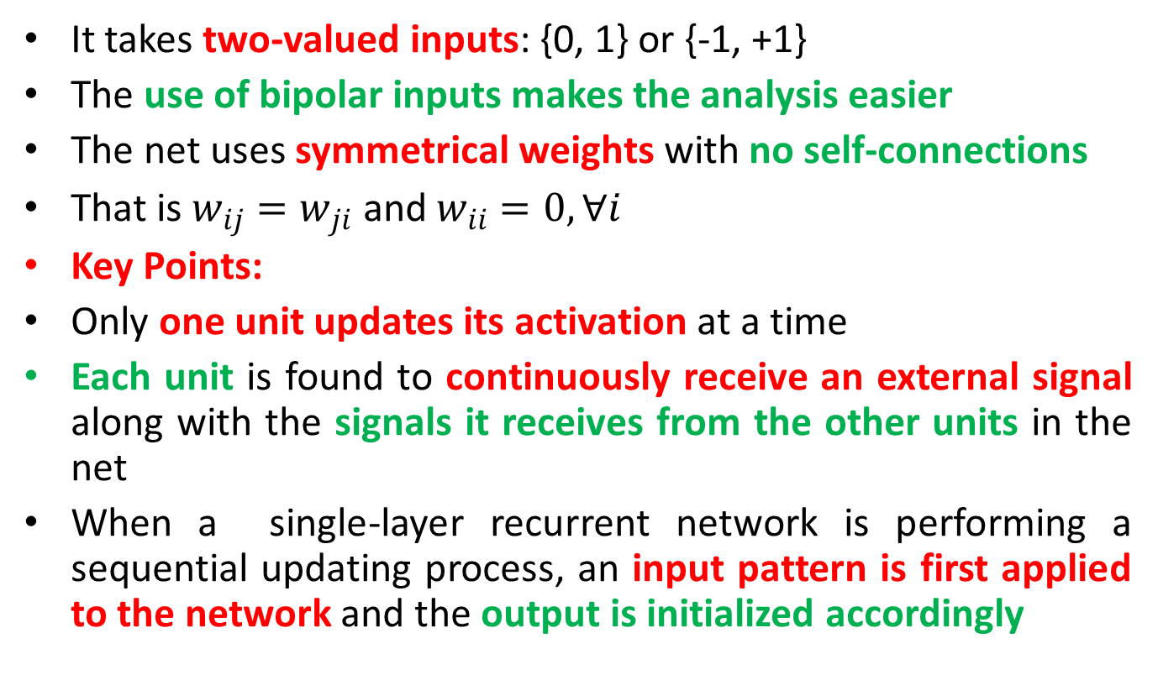
DISCRETE HOPFIELD NETWORK
It takes two-valued inputs: {0, 1} or {-1, +1}
The use of bipolar inputs makes the analysis easier
The net uses symmetrical weights with no self-connections
That is $w_{ij}=w_{ji}$ and $w_{ii}=0,∀i$
Key Points:
Only one unit updates its activation at a time
Each unit is found to continuously receive an external signal along with the signals it receives from the other units in the net
When a single-layer recurrent network is performing a sequential updating process, an input pattern is first applied to the network and the output is initialized accordingly

Slide 74
ARCHITECTURE OF A DISCRETE HOPFIELD NET
x1
x2
xi
xn
g
wi1
win
wn1
w21
w2n
w2i
wi2
wn2
w1n
wni
w1i
w12
Y1
Y2
Yi
Yn
y1
y2
yi
yn

Slide 75
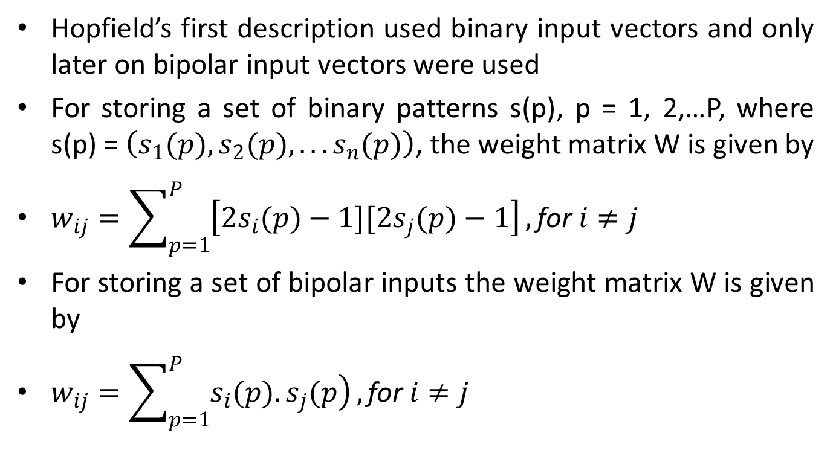
TRAINING ALGORITHM FOR DISCRETE HOPFIELD NETWORK
Hopfield’s first description used binary input vectors and only later on bipolar input vectors were used
For storing a set of binary patterns s(p), p = 1, 2,…P, where s(p) = $\left(s_{1}(p),s_{2}(p),...s_{n}(p)\right)$, the weight matrix W is given by
$w_{ij}=\sum_{p=1}^{P}{\left[2s_{i}(p)−1][2s_{j}(p)−1\right]},\text{for} i≠j$
For storing a set of bipolar inputs the weight matrix W is given by
$w_{ij}=\sum_{p=1}^{P}{\left.s_{i}(p).s_{j}(p\right)},\text{for} i≠j$

Slide 76
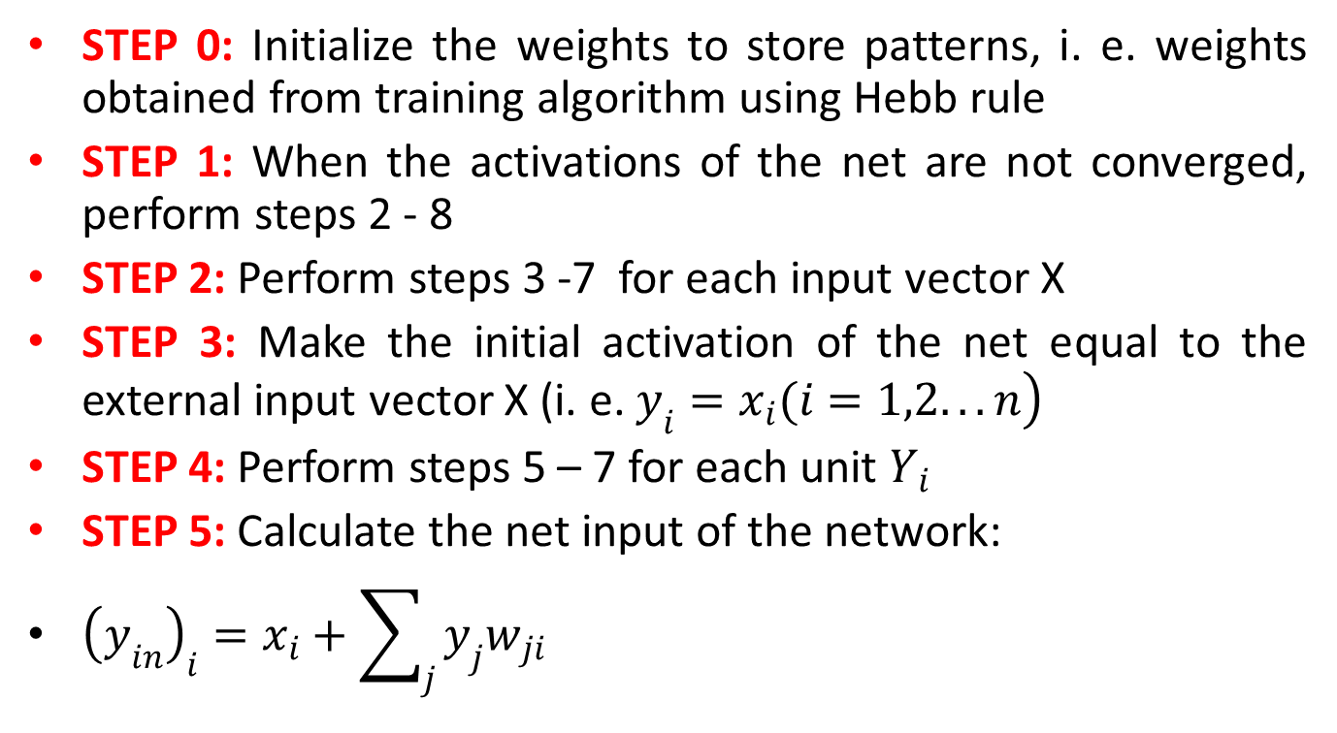
TESTING ALGORITHM FOR DISCRETE HOPFIELD NETWORK
STEP 0: Initialize the weights to store patterns, i. e. weights obtained from training algorithm using Hebb rule
STEP 1: When the activations of the net are not converged, perform steps 2 - 8
STEP 2: Perform steps 3 -7 for each input vector X
STEP 3: Make the initial activation of the net equal to the external input vector X (i. e. $\left.y_{i}=x_{i}(i=1,2...n\right)$
STEP 4: Perform steps 5 – 7 for each unit $Y_{i}$
STEP 5: Calculate the net input of the network:
${\left(y_{in}\right)}_{i}=x_{i}+\sum_{j}{y_{j}w_{ji}}$

Slide 77
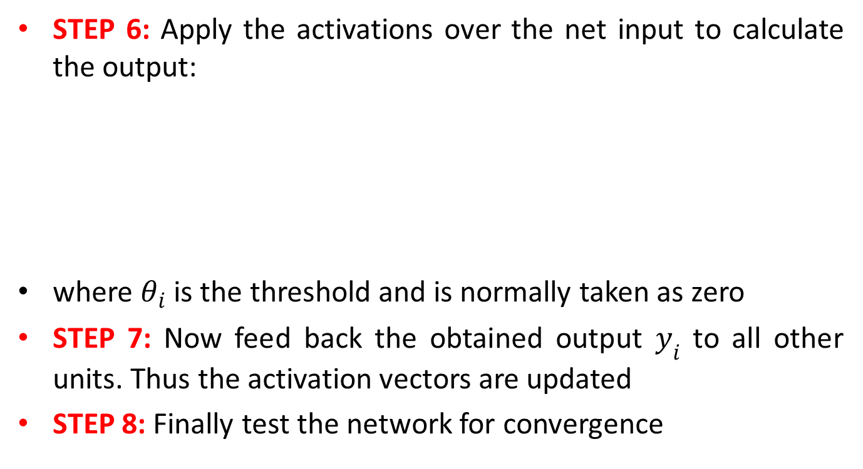
TESTING ALGORITHM FOR DISCRETE HOPFIELD NETWORK
STEP 6: Apply the activations over the net input to calculate the output:
where $θ_{i}$ is the threshold and is normally taken as zero
STEP 7: Now feed back the obtained output $y_{i}$ to all other units. Thus the activation vectors are updated
STEP 8: Finally test the network for convergence

Slide 78
CONTINUOUS HOPFIELD NETWORK
It is a discrete Hopfield network in which the time is assumed to be a continuous variable
The nodes of this network have a continuous graded output rather than a two-state binary output
The asynchronous updation of the units allows a function called as energy function or Liapunov function, for the net
The existence of this function enables us to prove that the net will converge to a stable set of activations
The energy of the network decreases continuously with time

